Slide 1

Hypothesis Testing
Suparna Kompalli and Carlos Gonzalez

Slide 2
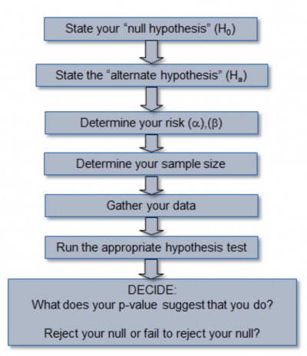
What is hypothesis testing?
Hypothesis Testing allows for us to choose between two viewpoints, called hypotheses.

Slide 3
Types of Hypotheses
Null Hypothesis (H_{o})
Alternative Hypothesis H_{a}
A model of how the data was generated
Any abnormalities under the null hypothesis are due to chance
The claim you want to test
A different view about how the data was generated

Slide 4
Specifying Hypotheses
We assume the null hypothesis:
is true by default
proposes no relationship between observations
Suppose you develop a new medical treatment and you want to show that it is indeed better than placebo. What should the Null Hypothesis be set to?

Slide 5
Specifying Hypotheses
We assume the null hypothesis:
is true by default
proposes no relationship between observations
Suppose you develop a new medical treatment and you want to show that it is indeed better than placebo. What should the Null Hypothesis be set to?
𝐻₀ = new treatment is equal or worse than placebo

Slide 6
Specifying Hypotheses
Alternative?
We assume the null hypothesis:
is true by default
proposes no relationship between observations
Suppose you develop a new medical treatment and you want to show that it is indeed better than placebo. What should the Null Hypothesis be set to?
𝐻₀ = new treatment is equal or worse than placebo

Slide 7
Test Statistic - the statistic that we use to simulate in order to decide between the two hypotheses.
First, we have to choose a statistic to simulate. The statistic has to be able to help us decide between the model and alternative views about the data. Essentially combines the data into 1 value that we can compare with another value.
We simulate the test statistic under the NULL HYPOTHESIS
Example: Number of Heads
Then create a histogram with the results
Empirical Distribution

Slide 8
Example: Flipping a coin
Consider the scenario where we flip a coin 100 times and get 80 heads.
Null Hypothesis: There is an equal chance of the coin landing on heads or tails.
Alternative Hypothesis: There is a higher chance of the coin landing on heads.

Slide 9
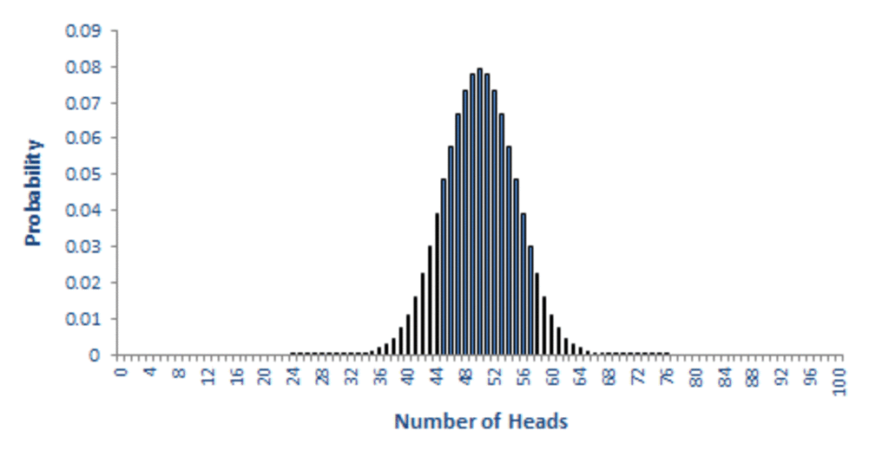
probability of Heads from 100 coin tosses

Slide 10
The P-Value
The p-value of a test is the chance, based on the model in the null hypothesis, that the test statistic will be equal to the observed value in the sample or even further in the direction that supports the alternative
the observed value of the test statistic is the value of the statistic you get from the data in the study, not a simulated value.
P-Value Cutoff
This is a hard cutoff determined BEFORE we see any results
conventionally 5% or 1%
If the calculated p-value is less than the p-value cutoff, we reject the null hypothesis and vice versa.

Slide 11
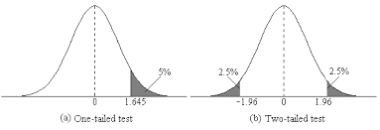
Tailed Tests

Slide 12
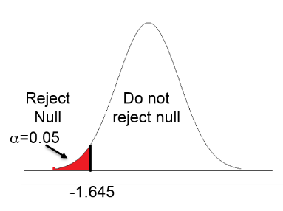
One - Tailed Tests
The region of null rejection is only on one side of the distribution
Suppose the null hypothesis is the mean is greater than or equal to 10
The alternative hypothesis would then be that the mean is less than or equal to 10.
Higher values of the test statistic would support the alternative hypothesis

Slide 13
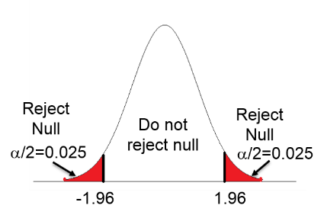
Two - Tailed Tests
The region of null rejection is on BOTH sides of the distribution:
Suppose this time the null hypothesis states that the mean is 10
That would mean that the alternative hypothesis would say that the mean is less than 10 or greater than 10
Extreme test statistic values on either side of the distribution would be in favor of the alternative hypothesis.

Slide 14
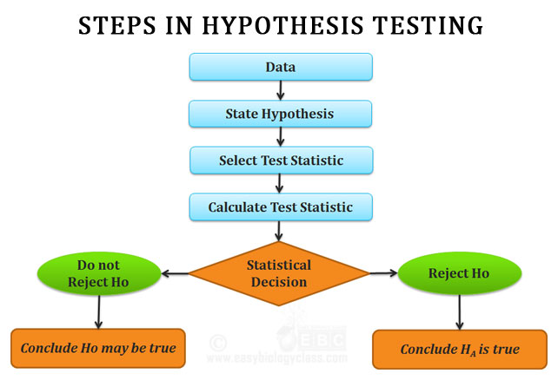

Slide 15
Thank you!

